Slide 1

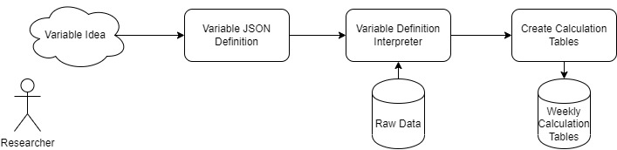
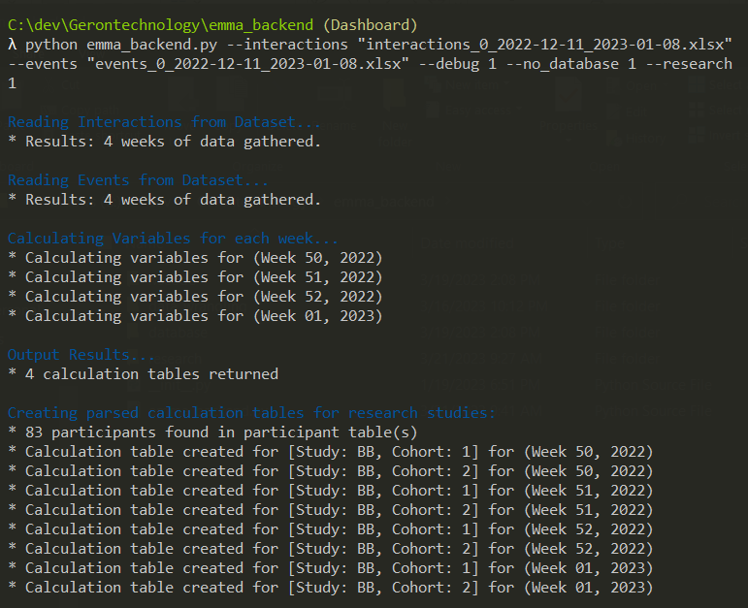
Development of a Backend Calculation Algorithm and User Interface for an iOS Application for Older Adults
Reagan Kelley ¹, Catherine Luna², Diane Cook¹ , & Maureen Schmitter-Edgecombe¹
¹College of Arts and Sciences, Psychology; ² Voiland College of Engineering, Computer Science
Scope…..
Older adults’ performances on cognitive tests in a clinical setting do not always accurately represent their self-perceived daily experiences.
Ecological momentary assessment (EMA) is useful for tracking daily experiences, such as cognitive fluctuations.
EMA was delivered via smartwatches to investigate dynamic associations between older adults’ fluctuations in cognitive performance and self-reports of current internal and external contextual states over seven days.
Hypotheses:
1) Cognitive performance will fluctuate throughout the week within and across days.
2) Cognitive performance will fluctuate in conjunction with internal and external contexts.
…..
Participants: 28 community-dwelling older adults recruited for a larger clinical trial assessing lifestyle factors and compensatory strategy use on cognitive health.
Procedure: During week one of the clinical trial, participants received a smartwatch which sent prompts four times a day for seven days (total of 28 prompts, see Figures 2-4).
The data collection included:
A 45-second one-back shape test (see Figure 1).
Likert-style questions assessing participants’ experiences
Internal contexts: Right now, I feel (1) mentally sharp, (2) physically fatigued, (3) stressed.
External contexts: (4) Right now my environment is distracting. Time of day of the response.
All study procedures were conducted at and approved by UC-Davis IRB.
Data Wrangling
Dashboard
Figure 1. EMMA Variable Calculation Process
Figure 2. Cross Correlation of N-Back Score with Feelings of Mental Sharpness
Problem
Researchers have many ideas for variables that can be collected and measured from EMMA data.
Problem: How to easily define new variables that can then be added to the data wrangling system, and how to store these calculations efficiently.
Solution
Rigidly define variables through JSON attributes
Design a variable definition interpreter that can understand the context of each variable definition.
Use all variable definitions to create calculation tables from the weekly stream of data.
Figure 2. Sample Data wrangling output
With over 100 variable definitions currently defined, our latest version can calculate weekly calculation tables for hundreds of participants throughout multiple studies within seconds.

